Slide 1
Information Technology Careers

Slide 2

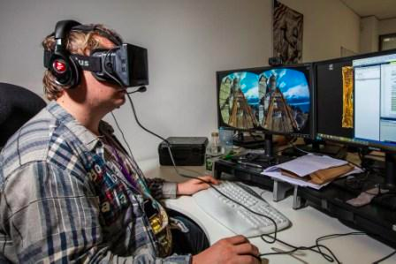


Four broad Information Technology Job Categories
IT Administration
Software development
Data managers
Engineering

Slide 3
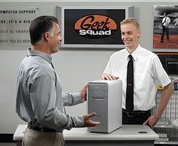
IT administration projects
Examples of projects a IT administrator might work on include:
Install, upgrade and fix PCs and servers
Help users with problems
Design and install wired and WIFI networks
Manage server backups
Manage firewalls, routers, anti-virus and security matters.
Manage server-based applications – email, web, database.

Slide 4
Software Development Projects
Examples of projects a computer scientist might work on include:
Computer games and graphics
Search engines
Mobile applications
Web applications
Operating systems

Slide 5
Data Manager Administrator Projects
Examples of projects a DBA might work on include:
Accounting, inventory, payroll, sales force applications
Analyze data from a range of sources, including click streams, sensors, social media posts, transactions, log files and GPS plots.

Slide 6
Computer Engineering Projects
Examples of projects a computer engineer might work on include:
Design and create new computers, servers, computer displays, routers, printers, mobile phones etc.
Create computer solutions for companies
Self-driving cars
Robotics
Google glass

Slide 7

Web Designer vs Devloper

Slide 8
Web Developer
http://cleanvideosearch.com/media/action/yt/watch?videoId=mlfSZChro8E

Slide 9
Computer Programming
http://cleanvideosearch.com/media/action/yt/watch?videoId=Z9tbEd-7Em0

Slide 10
Information Technology
http://cleanvideosearch.com/media/action/yt/watch?videoId=u9CF2JgmD3o

Slide 11
Database Administrator
http://cleanvideosearch.com/media/action/yt/watch?videoId=t0C9eG7obyk

Slide 12
US News Magazine Report
http://money.usnews.com/careers/best-jobs/rankings/best-technology-jobs
http://www.bls.gov/ooh/computer-and-information-technology/home.htm
Compare four careers and fill in the following table:
Career | Salary Range | Amount of Education Needed | Number of Jobs in USA | Job Growth % Estimate
Computer Support Specialist
Web Developer
Computer Systems Analyst
Database Admin

Slide 13
Required Classes for 5 programs of study at Maricopa County Community Colleges
Web and Graphic Design
https://aztransmac2.asu.edu/cgi-bin/WebObjects/acres.woa/wa/freeForm3?id=63317
Programming and Mobile Development
https://aztransmac2.asu.edu/cgi-bin/WebObjects/acres.woa/wa/freeForm3?id=83468
Computer Programming
https://aztransmac2.asu.edu/cgi-bin/WebObjects/acres.woa/wa/freeForm3?id=26042
Computer and Network Technology
https://aztransmac2.asu.edu/cgi-bin/WebObjects/acres.woa/wa/freeForm3?id=47189
Database Development
https://aztransmac2.asu.edu/cgi-bin/WebObjects/acres.woa/wa/freeForm?id=24226
Choose two of the programs of study and make a list of required classes.
Which degree looks easier? _____________
Which degree looks more interesting to you? ___________

Slide 14

Why should you choose programming from the career point of view?
Because you enjoy the sense of creativity.
Because you work for yourself and don’t bother for interaction with people directly.
Flexibility to work from office or home.

Slide 15

Why should not you choose Programming from the career point of view?
Pressure from job outsourcing.
Erratic hours
Repetitive
Sharp Deadlines
Keep pace with changing frameworks and technology.

Slide 16

Why should you choose Administration from the career point of view?
Always something different
New challenges
Controlling and coordinating with number of professionals.

Slide 17
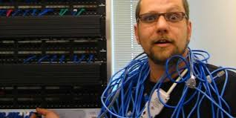
Why should not you choose Administration from career point of view?
Stressful working hours.
Sometimes boring taking backups, restoring, fixing, installing, updating, scanning, etc.

Slide 18


You can’t go wrong if you enjoy the work…
Both System Administration and Developer are highly sought after professionals. Both will remain in demand forever.
Choose your personal preference and become an expert in your field.

